Slide 1


Hello !
Maria Naggaga
@LadyNaggaga
Notes:
Hello I am Maria! I am Ugandan and leaved in the UK. So, my accent sometimes has people guessing.
If you want to reach me on the Twitters I am @LadyNaggaga. Think Lady gaga and add an Na at a beginning. I got this name from a Telemarkter. Who would have guessed.

Slide 2
Legacy …What ?
Notes:
So, I am going to speak about legacy…… and people’s usually react what do you mean ?? So, it made for the perfect title Legacy… What? And what applications mean to different people. In particular Asp.net

Slide 3

Notes:
Legacy is always a tricky word to use ! People usually think of the glory days , limited access

Slide 4

Notes:
Exclusive ! In some cases this can be regards to how a language is use like , C# - you think native, C++

Slide 5

Outdated
Notes:
Outdated ! Starting something new

Slide 6

Memory Lane
Stuff we loved
Notes:
A trip down memory Lane GIF ! Memory lane things we loved, used and we don’t anymore of the changed to be something else

Slide 7
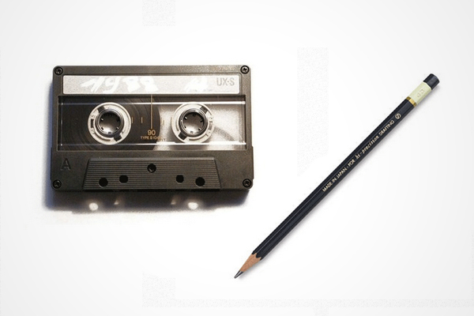
Do you know?
Notes:
Who knows what this was used for ? Pencil and a cassette tape

Slide 8
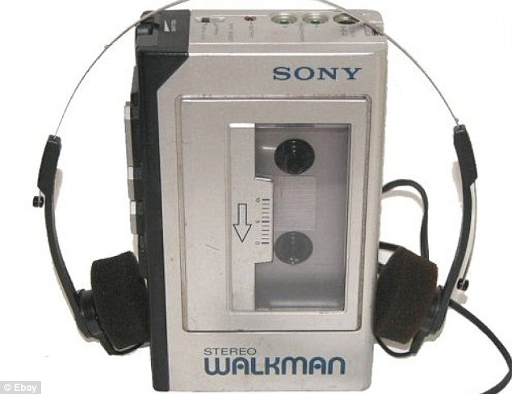
Notes:
This

Slide 9
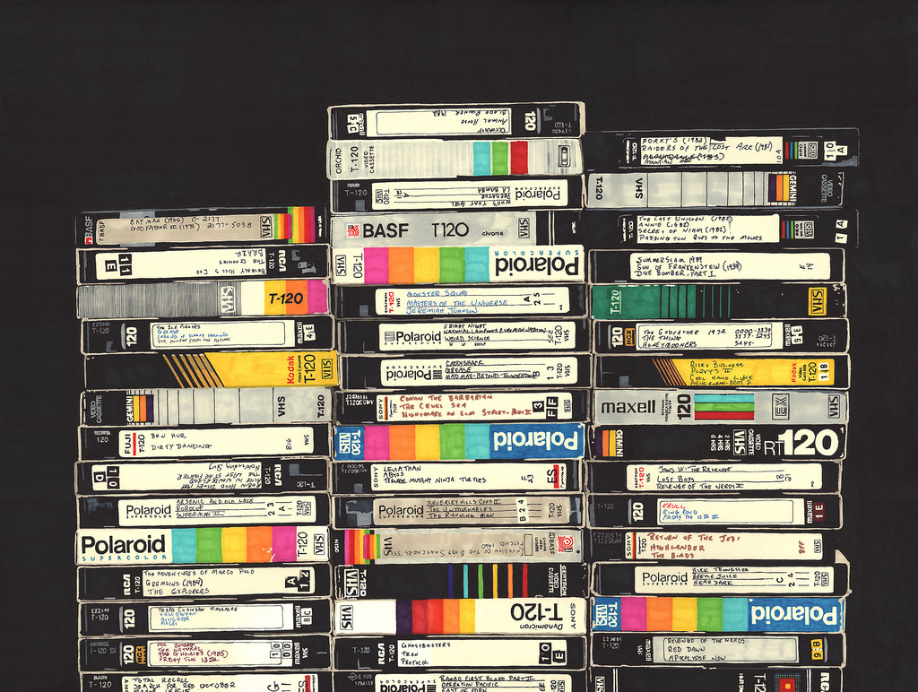
Notes:
Remember when we had entire rooms in our home dedicated all our videos. Then you have the incredible decision on which one we had to tape over which ones to keep ??? Because literally there were so no where else to keep them.

Slide 10
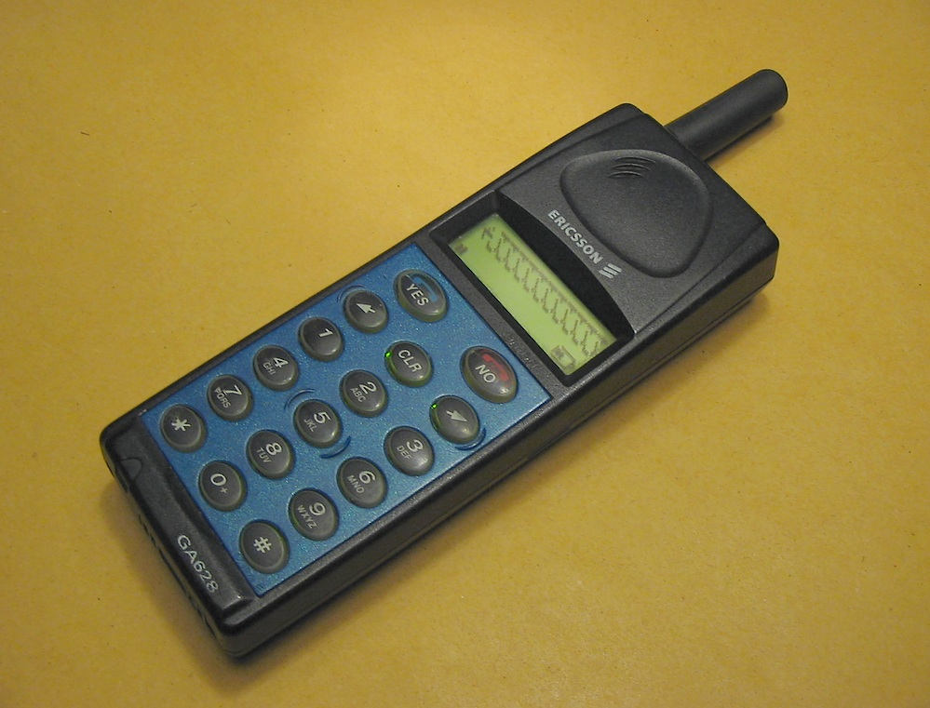
My first phone
Notes:
Who remembers this ? The Brick ! My first cell phone a hand me down from one of my sisters

Slide 11


Slide 12
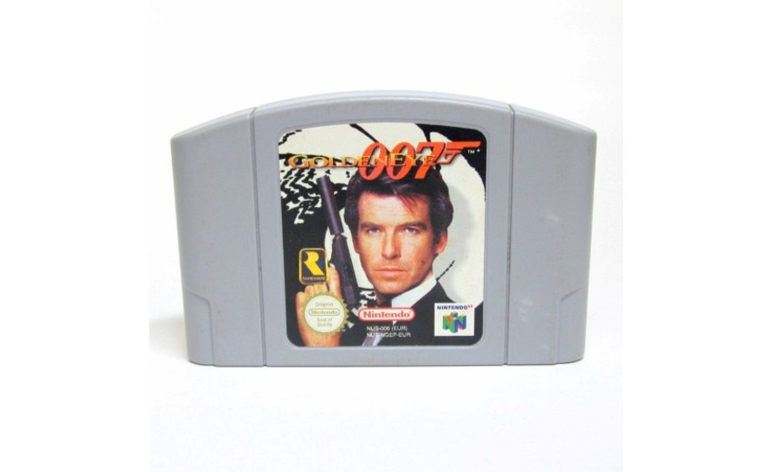
Notes:
This

Slide 13
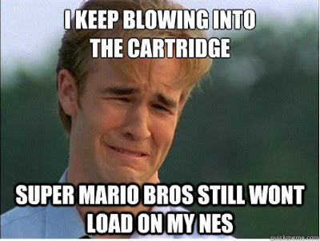
Notes:
After 12 hours straight … you are saying this

Slide 14

Notes:
This opened up our world !

Slide 15
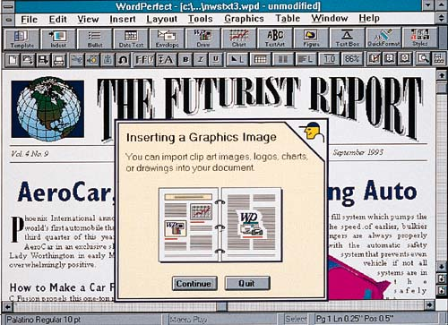
Notes:
Word prefect let anyone type up document no training required .

Slide 16
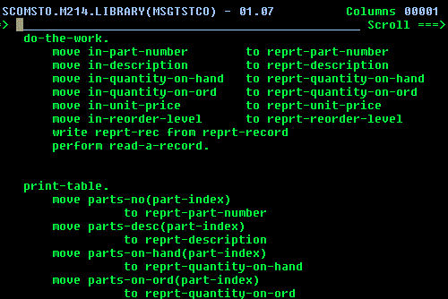
Notes:
Languages that used to put a smile on our faces : Cobol

Slide 17
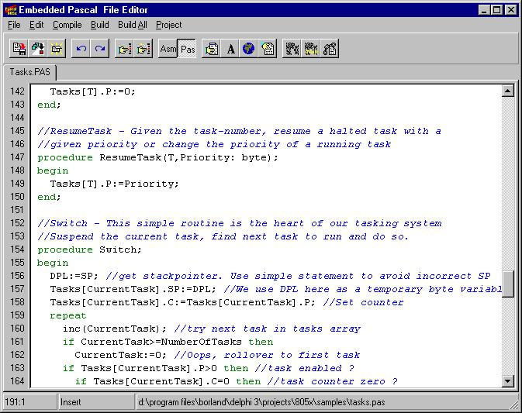
Notes:
Languages that used to put a smile on our faces : Pascal ,

Slide 18



Notes:
Languages that used to put a smile on our faces : Dreamweaver , Cold Fusion, Flash . Dreamweaver was the first IDE I used

Slide 19
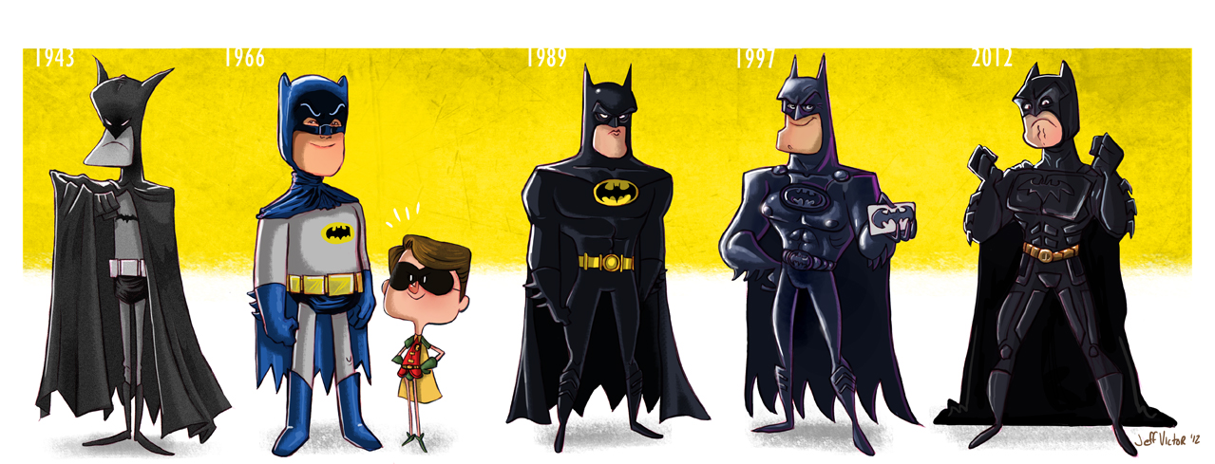
Classic, New & Improved
Notes:
What a lot of these have in common is even though some don’t exist anymore is there are the Same things new look . Even though the ones in the middle might have been effy. You know how which just pretend that Val Klimr and George Cloone were batman

Slide 20
Asp.Net
Now
Notes:
Asp.net Now ! What does it look like now ? As an evangelist I code with a variety of developers from uni students, indie developers , young startups and a huge number of web developers. So understanding them is key. My general demographic looks doesn’t think about Asp.Net

Slide 21

Why?
Notes:
Why Asp.net Why now ? What does asp.net mean for them is it all new set of tools, OS or environments they don’t necessarily use

Slide 22
Developing for the web today
Notes:
Developing for the web today means flexibility. I am young web dev! The web made up of lot of moving parts that allows the developer to use what they want.

Slide 23
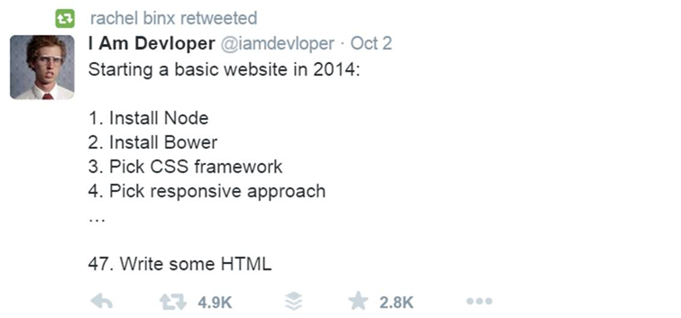
Notes:
Building for the web requires loads of tools libraries !

Slide 24

Adventure
Notes:
The growth of the web and especially JS has sprang the growth of the fearless Coder, they will try anything and want to be a part of a great community . As an evangelist with a variety of developers from uni students, indie developers , young startups and a huge number of developers. So why?

Slide 25
So… Why?
Asp.Net
Notes:
So, for this fearless coder, the dare devil, the constant learner. Why Asp.Net? Will Vnext is open source.

Slide 26
Cross Platform !
Notes:
It’s Cross platform

Slide 27
Open Source !
Notes:
It’s open source

Slide 28

I’m listening
Notes:
The conversation starts!! They are willing to have the conversation !

Slide 29

Something Familiar
Notes:
Something familiar. More than anything you can use the tools, frameworks that you are used to ! It has been my experience that the .

Slide 30
File, New , Project
Visual Studio
Notes:
Visual Studio 2015 makes it really simple File new project. With Grunt- task runner, Bower- package manager , gulp -Automate and enhance your workflow , and npm already packaged for you

Slide 31

Notes:
Late last year I was introduce to Asp.net . I haven’t really done web dev till this. I found it really interesting how you could get something so traditionally MSFT working in a non-traditional environment. And it got really popular , people began to tweet out the post discover it and asking me questions.

Slide 32
It’s all about command line
Notes:
Work in the command line ! An increasing number of developers like to have control of setting up their environment.
For a complete clean install. As in this was the first time I had ever done this I had my Asp.net running on my Mac . I took about 12 /13 commands for me to set up my environment.. Why? I liked it was I able to figure out all the puzzles.

Slide 33
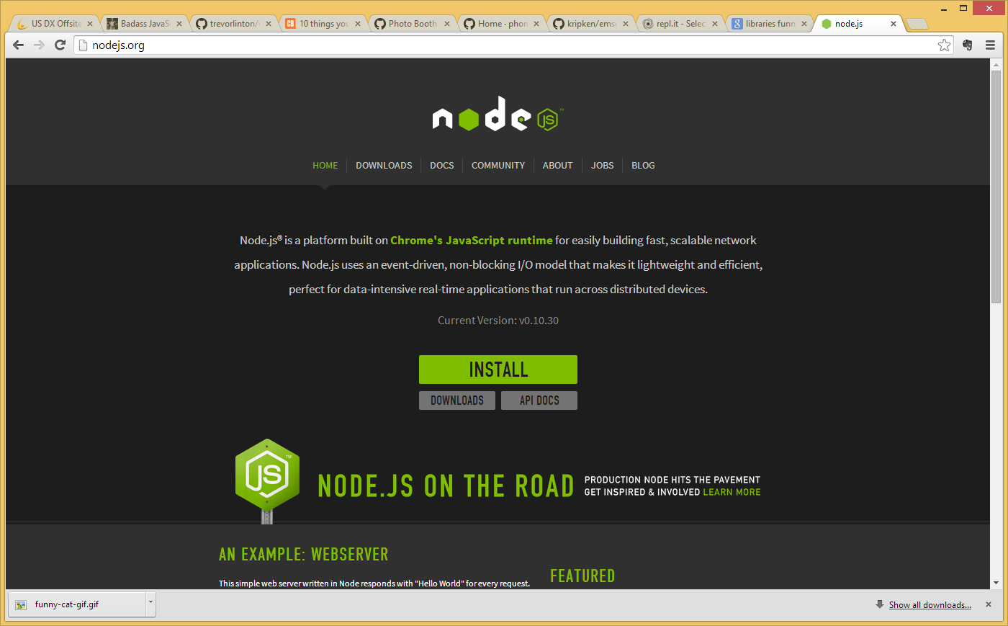
1 | node --version && npm --version
Notes:
You can run a webserver!! Client side
http://nodejs.org/
Node Js a and Microsoft
http://azure.microsoft.com/en-us/develop/nodejs/
Open up page to show Azure compatibility

Slide 34
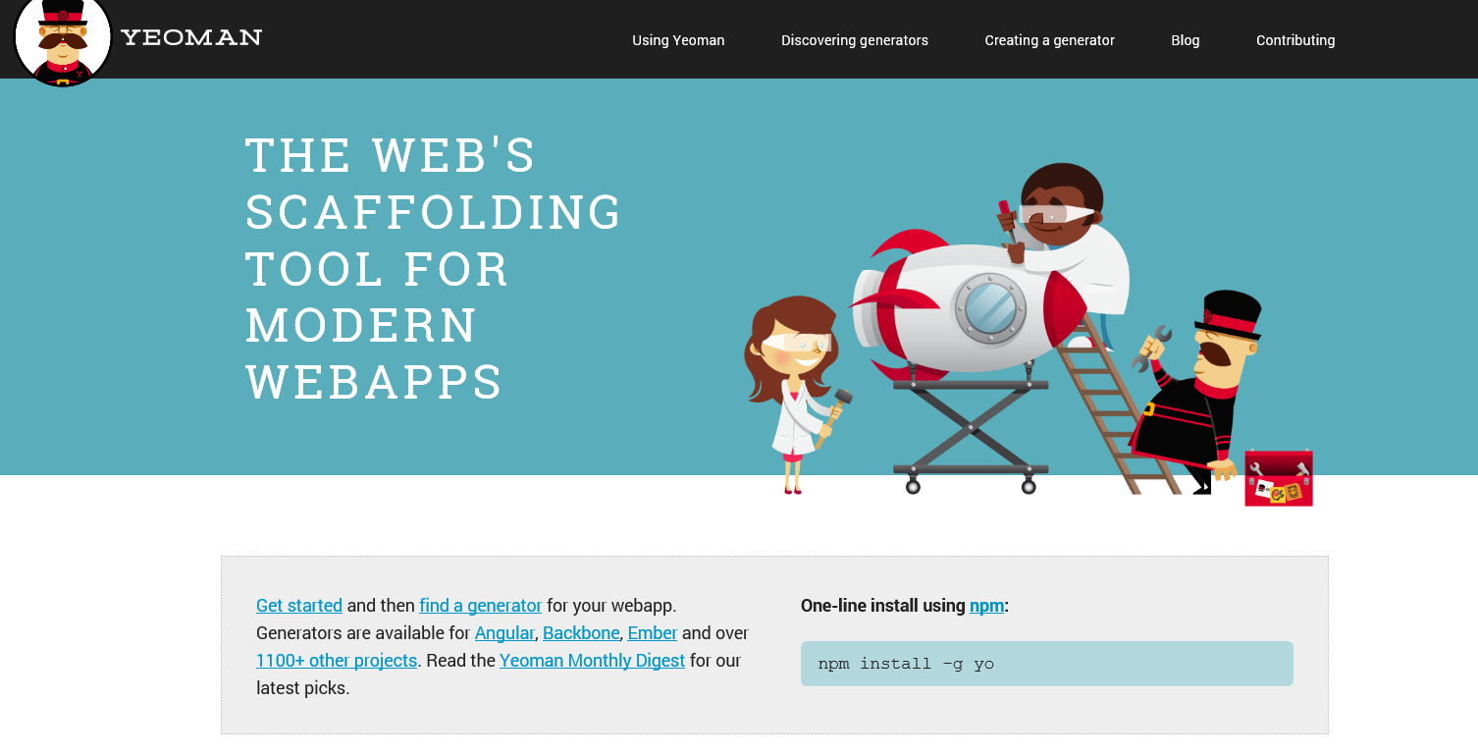
npm install —global yo
npm install -g generator-aspnet
yo aspnet: MvcController
Notes:
Yeoman is an open source sleek scaffolding tool that consists frameworks that make it quick and easy to build web applications. The neat thing about Yeoman is it combines several functions into one place, such as template generators
http://yeoman.io/

Slide 35
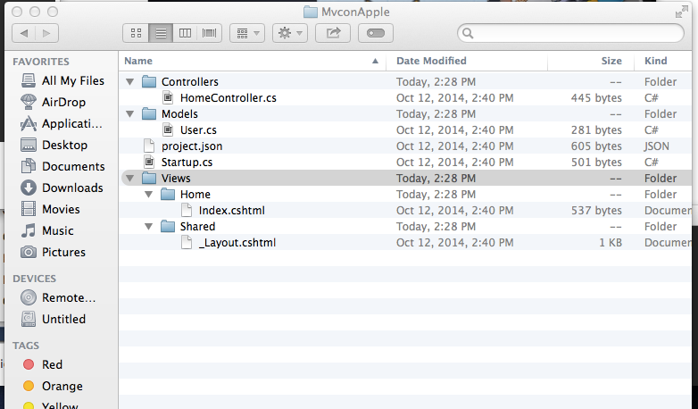
Model, View, Controller
Notes:
You navigate to this really familiar to structure

Slide 36
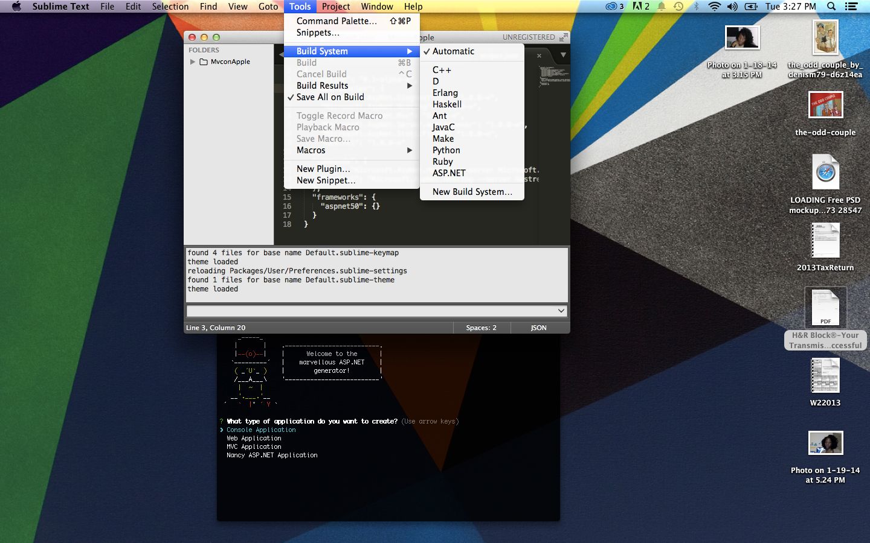
Notes:
With tools like Kuluture and ominsharp ! You are running a asp.net running on a mac

Slide 37
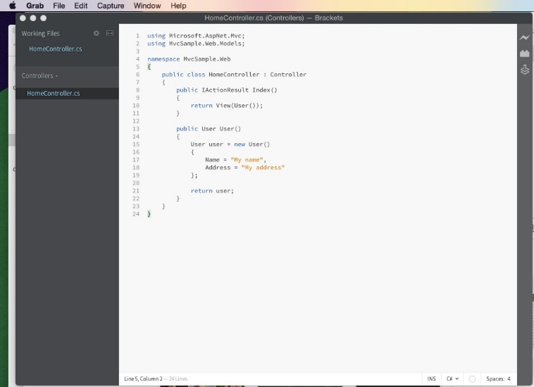
Notes:
Bracket as well.

Slide 38

Notes:
What’s next those who haven’t tried it ! Try it. Share, learn , contribute and create ☺

Slide 39
Bye!
Maria Naggaga
Microsoft Technical Evangelist NYC
@LadyNaggaga
Marianaggaga.com

Slide 40


